Slide 1
Discrete Optimization
Elizabeth Davenport, Megan Johnston, Calli Nguyen, Shuowen Wei
Apr. 18

Slide 2
Framework
A general introduction to discrete optimization
Topic 2 ?
Discrete Optimization in medical Imaging
Topic 4 (solve mixed integer optimization using ga toolbox)

Slide 3
Definition of discrete optimization
Discrete optimization is a branch of optimization in applied mathematics and computer science, as opposed to continuous optimization, the variables used in the mathematical program (or some of them) are restricted to assume only discrete values, such as the integers
Two notable branches of discrete optimization are:
combinatorial optimization, which refers to problems on graphs, matroids and other discrete structures
integer programming

Slide 4
Definition of discrete optimization
combinatorial optimization is a topic that consists of finding an optimal object from a finite set of objects
An integer programming problem is a mathematical optimization in which some or all of the variables are restricted to be integers

Slide 5
Some examples in discrete optimization
Integer linear programming
Set cover problem
Knapsack problem
Graph theory
Minimum spanning tree
Vertex cover problem
Traveling salesman problem (Hamiltonian circuit)
Shortest path problem
Scheduling problem
Maximum flow problem

Slide 6
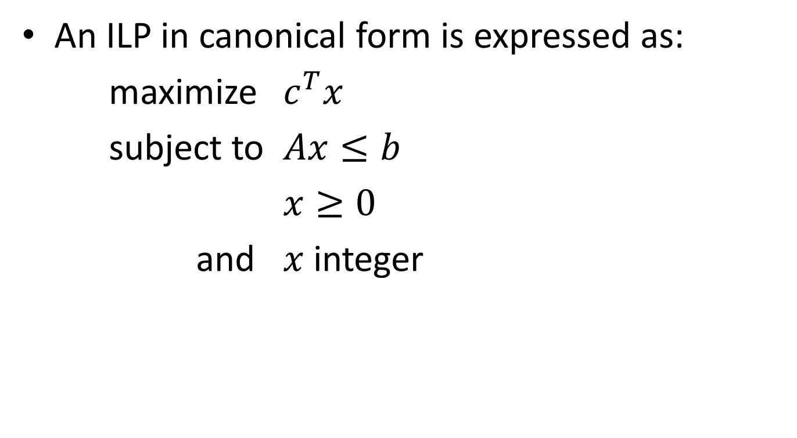
Integer linear programming (NP-hard)
An ILP in canonical form is expressed as:
maximize $c^{T}x$
subject to $Ax≤b$
$x≥0$
and $x$ integer

Slide 7
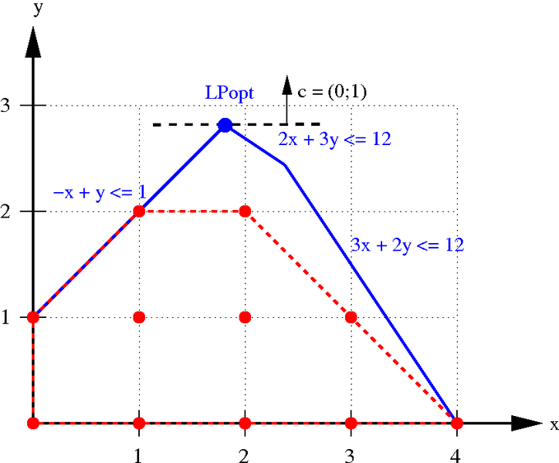
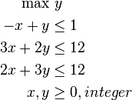
Integer linear programming (NP-hard)
An example:

Slide 8
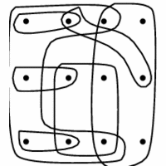
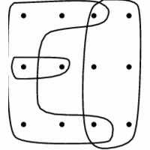
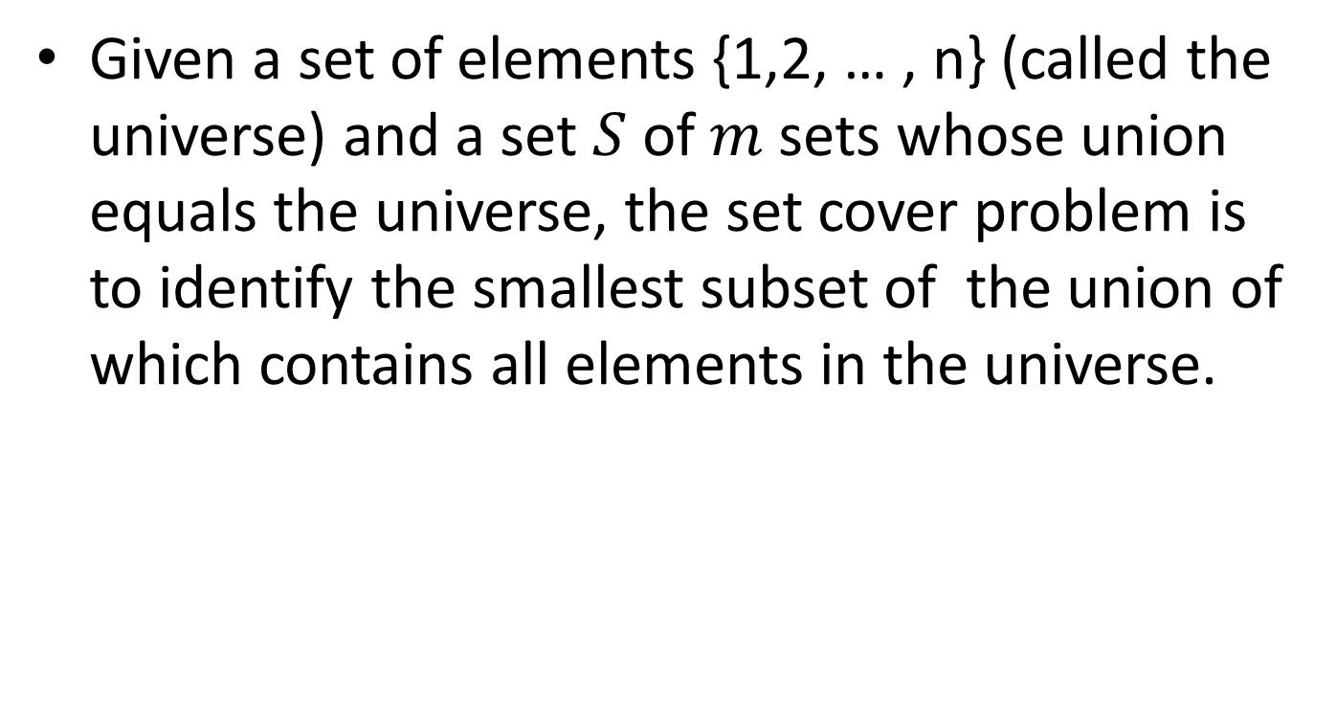
Set cover problems (NP-hard)
Given a set of elements $\text{\{1,2, … , }\text{n}\text{\}}$ (called the universe) and a set $S$ of $m$ sets whose union equals the universe, the set cover problem is to identify the smallest subset of the union of which contains all elements in the universe.

Slide 9
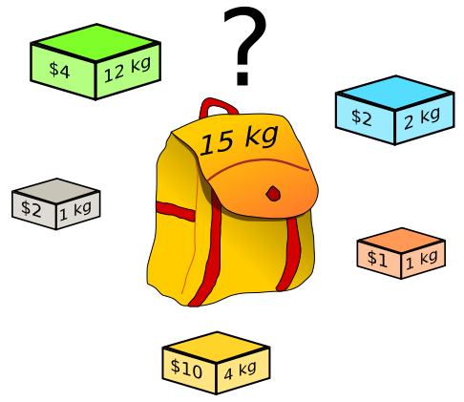
Knapsack problems (NP-hard)
Given a set of items, each with a weight and a value, determine the number of each item to include in a collection so that the total weight is less than or equal to a given limit and the total value is as large as possible.
Backtracking Algorithm

Slide 10
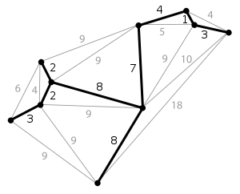
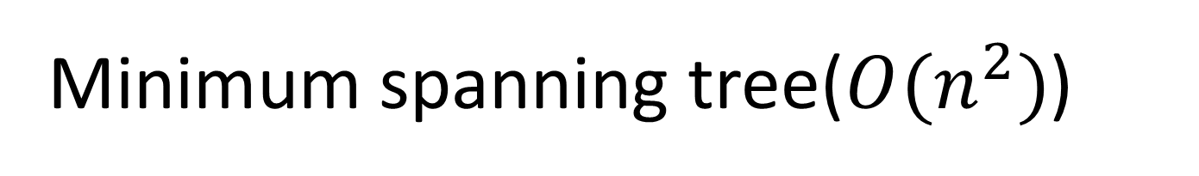
Minimum spanning tree($O(n^{2})$)
A minimum spanning tree (MST) is then a spanning tree with weight less than or equal to the weight of every other spanning tree.
Kruskal's algorithm (greedy Alg.)

Slide 11
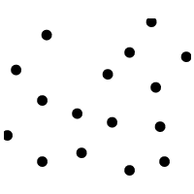
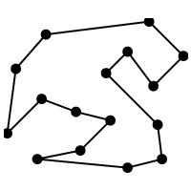
Traveling salesman problem (NP-hard)
The travelling salesman problem (TSP) asks the following question: given a list of cities and the distances between each pair of cities, what is the shortest possible route that visits each city exactly once and returns to the origin city?

Slide 12
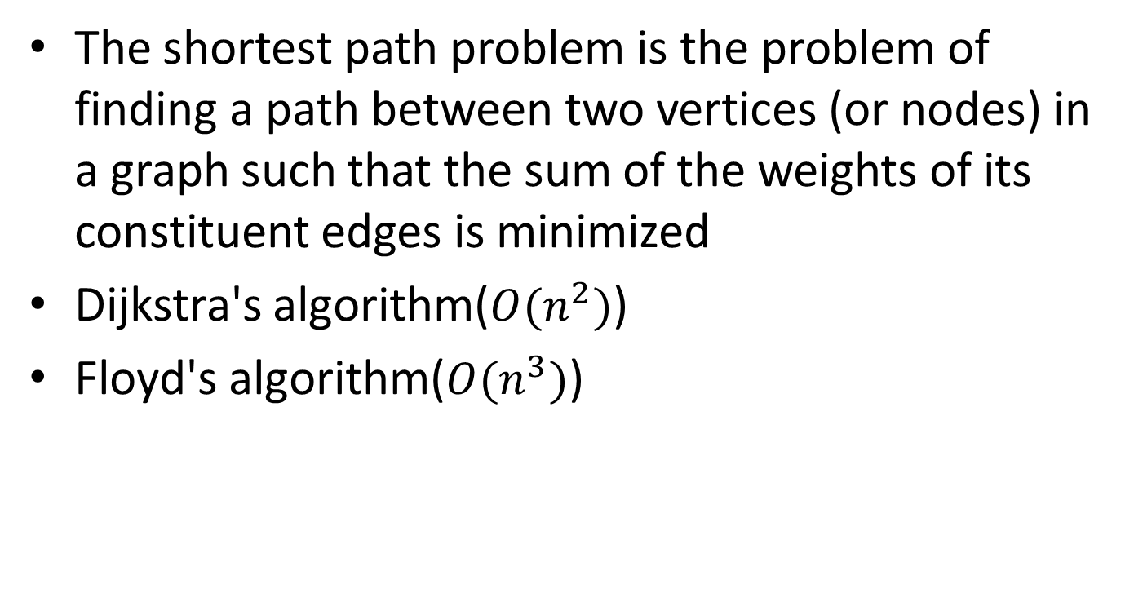
Shortest path problem
The shortest path problem is the problem of finding a path between two vertices (or nodes) in a graph such that the sum of the weights of its constituent edges is minimized
Dijkstra's algorithm($O(n^{2})$)
Floyd's algorithm($O(n^{3})$)

Slide 13
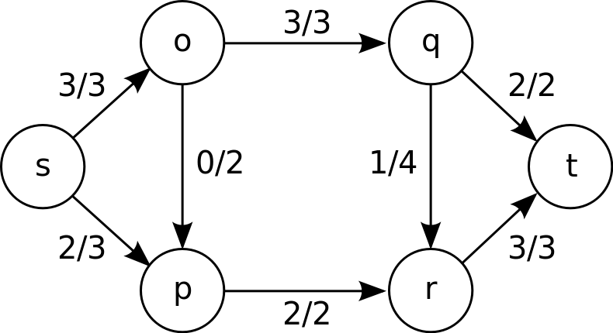
maximum flow problem (NP-hard)
Maximum flow problem is to find a feasible flow through a single-source, single-sink flow network that is maximum
Max-flow min-cut theorem

Slide 14
Topic 2

Slide 16
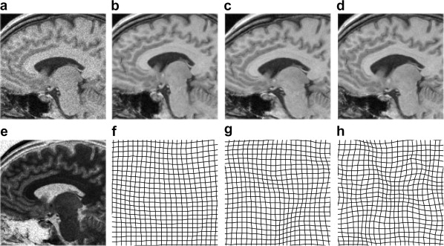
Discrete Optimization in Medical Imaging
Glocker B, Komodakis N, Tziritas G, et al. Dense image registration through MRFs and efficient linear programming. Medical Image Analysis 2008;12:731-741

Slide 17
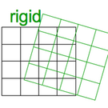
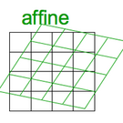
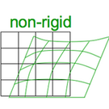
Basics of Image Registration
Images must be registered in order to compare multiple subjects in a group
From the most simple to the most complex:
Rigid
Affine
Non-rigid
Varying DOF

Slide 18
Why does medical imaging need optimization?
Curse of Dimensionality
1 million + voxels
Curse of non-convexity
Ill-posed problem (more parameters than constraints)
Curse of non-linearity
Not all registrations are affine
Curse of modularity
Solutions for very specific problems

Slide 19
What have they already tried?
Powell’s (conjugate direction) method
Downhill Simplex
Levenberg-Marquardt
Currently used by SPM8
Newton-Raphson
Stochastic search methods
Gradient descent methods
Quasi-exhaustive search methods

Slide 20
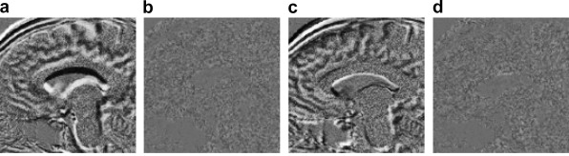
What’s going on now?
Glocker et al. recently published a paper using discrete optimization techniques for image registration
Model registration as Markov Random Field
MRF is optimized using the primal-dual schema
Performs well on MRI brain image registration
Glocker B, Komodakis N, Tziritas G, et al. Dense image registration through MRFs and efficient linear programming. Medical Image Analysis 2008;12:731-741

Slide 21
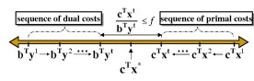
The Primal-Dual Schema
Main goal: Minimize gap between the primal and dual costs

Slide 22
Topic 4

Slide 24
Reference
wikipedia.org
http://www.cs.sunysb.edu/~algorith/implement/syslo/implement.shtml

